Slide 1
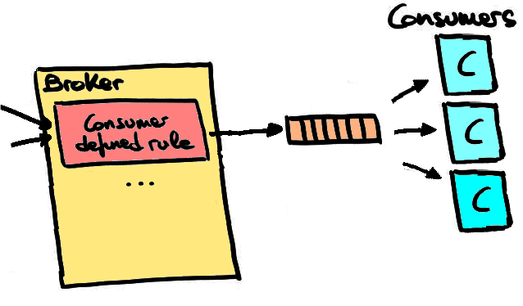
Topic Based Classification
Publisher Subscriber System
By: Hanifa Hotelwala, Bijay Ranabhat, and Shahraiz Niazi

Slide 2
Objectives
Understand real time data streaming using a topic-based Pub-Sub system
Understand Publisher-Subscriber design pattern
Learn benefits of ActiveMQ and Apache Kafka for a Pub-Sub system

Slide 3
What is a Publisher-Subscriber System?
Messaging design pattern
Basic set-up:
Sender
Receiver
Improves basic design pattern by introducing scalability and modularity

Slide 4
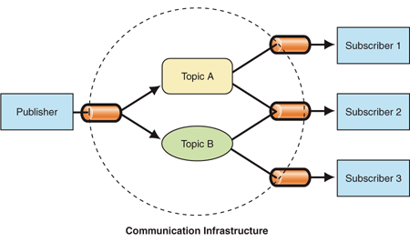
Receiver 1
Basic design pattern
Sender
Receiver 2
Receiver 3
Publisher Subscriber design pattern

Slide 5
Basic Design Patterns
Can not send messages without knowing who the receivers are
Increasing # of senders must be done manually in program
Not modular
Not scalable
Receiver 1
Sender
Receiver 2
Receiver 3

Slide 6
Solution: Pub-sub system
Extends the communication infrastructure by including a topic for each message
Enables listening applications to receive messages from only specified topics
Creates a mechanism that sends messages to all interested receivers

Slide 7
Publisher Subscriber
Producers publish information on a software bus
publish() - generates event
Software Bus (PubSub server)
Holds various events
Defines a uniform message structure by organizing each event created
Consumers subscribe to the specific information they want to receive from that bus
subscribe() / unsubscribe()
Once subscribed, origin of the sources is unknown and publisher is not notified

Slide 8
Topic-Based Pub-sub System
Subscriber
Finds specific topics through keywords
Publishers
Role = same
Creates topics/subjects
All information is stored in the software bus
Message Queueing
Establishes FIFO scheme
Programming abstractions
Topic Abstractions
Easier to understand
Enforces a systematic platform to enable message queueing

Slide 9
Benefits of a Pub-Sub
In modern cloud architecture applications are decoupled into smaller pieces independent from one another
Easier to develop, maintain, and deploy
Provides instant event notification for distributed applications
Ensures reliability and scalability

Slide 10
Code Implementation - Screencast
3-4 minutes of quick overview of the code and the implemented model

Slide 11
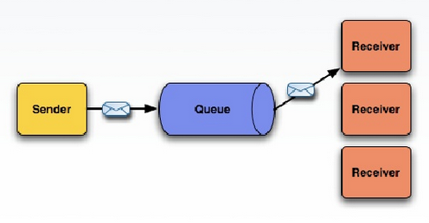
Apache ActiveMQ
ActiveMQ is an open-source, messaging software which can serve as the backbone for an architecture of distributed applications built upon messaging
It is used to reliably communicate between two distributed processes
Logs
ActiveMQ
Apache Kafka

Slide 12
ActiveMQ - use cases
Supports a variety of Cross Language Clients and Protocols such as Java, C, C++, C#, Ruby, Perl, Python, PHP
Examples of some use cases
Transactional messaging
High performance market data distribution
Clustering and general purpose async messaging model
Web Streaming of data
RESTful API to messaging using HTTP

Slide 13
Apache ActiveMQ - Why we use it?
Allows applications built with different languages and on different operating systems to integrate with each other
Location transparency
Reliable communication
Scaling
Asynchronous communication
Reduced coupling
Notes:
Allowing applications built with different languages and on different operating systems to integrate with each other
Location transparency - client applications don’t need to know where the service applications are located
Reliable communication - the producers/consumers of messages don’t have to be available at the same time, or certain segments along the route of the message can go down and come back up without impacting the message getting to the service/consumer
Scaling - can scale horizontally by adding more services that can handle the messages if too many messages are arriving
Asynchronous communication - a client can fire a message and continue other processing instead of blocking until the service has sent a response; it can handle the response message only when the message is ready
Reduced coupling - the assumptions made by the clients and services are greatly reduced as a result of the previous 5 benefits. A service can change details about itself, including its location, protocol, and availability, without affecting or disrupting the client.

Slide 14
Apache Kafka
Apache Kafka is a software where topics can be defined
A topic is a category name to which messages are stored and published.
Applications may connect to this system and transfer a message onto the topic.(Publishers)
Examples of Messages:
Information about an event that has happened on your website
A simple text message that is supposed to trigger an event
Another application may connect to the system and process messages from a topic.(Subscribers/Consumers)
There is a TCP connection between the application and the Kafka Broker.

Slide 15
Apache Kafka
Distributed messaging system with integrated message queuing system,
Used for collecting and delivering high volumes of log data with minimal delay,
Just like a messaging system where you can access data at your own rate whenever,
Kafka has higher throughput than conventional messaging systems

Slide 16
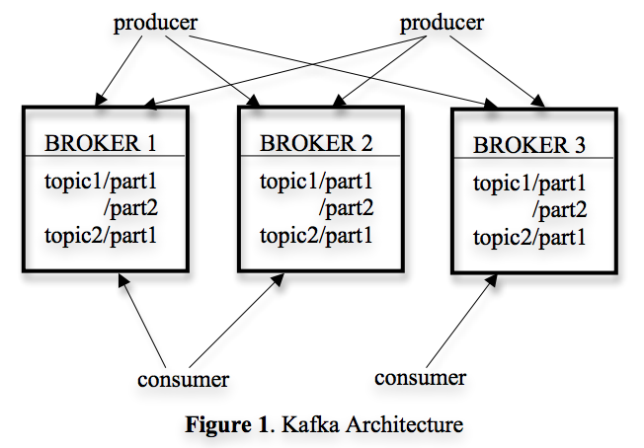
Apache Kafka
Uses a partitioning system for every topic (data within the partition is ordered).
Provides integrated distributed support and can scale out by using consumer groups.
Multiple consumer groups can read from the same set of topics, and at different times.
Used for processing huge volume of log data streams.
Kafka is very fast and guarantees zero downtime and zero data loss as it has a system of sending acknowledgements and creating replicas of a partition.

Slide 17
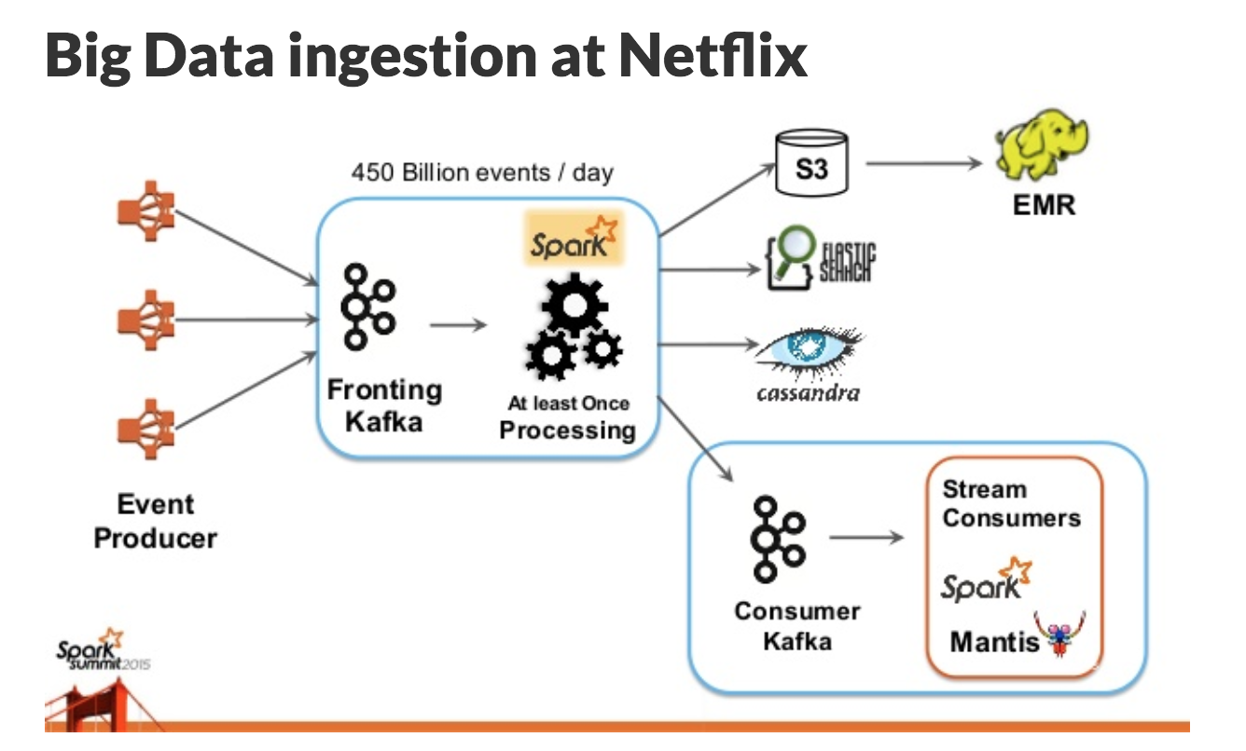
Uses of Apache Kafka
Messaging
In comparison to most messaging systems Kafka has better throughput, built-in partitioning, ordering within the partition,replication, and fault-tolerance
Website Activity Tracking
Kafka can track site activity (page views, searches, or other actions users may take) as a set of real time publish-subscribe feeds
Was originally designed by LinkedIn, used by platforms like LinkedIn, Netflix, etc.

Slide 18
Sources
Kreps, J., Narkhede, N., & Rao, J. (2011). Kafka: a Distributed Messaging System for Log Processing. ACM SIGMOD Workshop on Networking Meets Databases, 6. Retrieved from
http://pages.cs.wisc.edu/~akella/CS744/F17/838-CloudPapers/Kafka.pdf
Patrick Th. Eugster, Pascal A. Felber, Rachid Guerraoui, and Anne-Marie Kermarrec. 2003. The many faces of publish/subscribe. ACM Comput. Surv.35, 2 (June 2003), 114-131. DOI=http://dx.doi.org/10.1145/857076.857078
“Benefits of Pub/Sub Messaging” https://aws.amazon.com/pub-sub-messaging/benefits/
Code Implementation Sources:
Source code to obtain logs
https://social.msdn.microsoft.com/Forums/en-US/3e8486d3-8fee-4477-945f-44d9576a8cb8/c-code-to-read-windows-event-viewer-system-log-in-real-time?forum=csharpgeneral
ActiveMQ
http://activemq.apache.org/getting-started.html
https://tech.lalitbhatt.net/2014/08/activemq-introduction.html
http://activemq.apache.org/
http://blog.christianposta.com/activemq/what-is-activemq/
Dll file
https://www.solvusoft.com/en/files/missing-not-found-error/dll/windows/activemq-apache-org/apache-nms-for-activemq-classhttps://www.solvusoft.com/en/files/missing-not-found-error/dll/windows/activemq-apache-org/apache-nms-for-activemq-class-library/page/1/-library/page/1/
https://remark.wordpress.com/articles/messaging-with-net-and-activemq/

